Slide 1

TFB1123/TEB1073
ENTERPRISE RESOURCE
PLANNING (ERP)
MARKETING INFORMATION SYSTEMS AND THE SALES ORDER PROCESS
TS. DR. HALIMATON SAADIAH BT HAKIMI
DEPARTMENT OF COMPUTING FACULTY OF SCIENCE, MANAGEMENT & COMPUTING

Slide 2

Chapter Objective

Slide 3
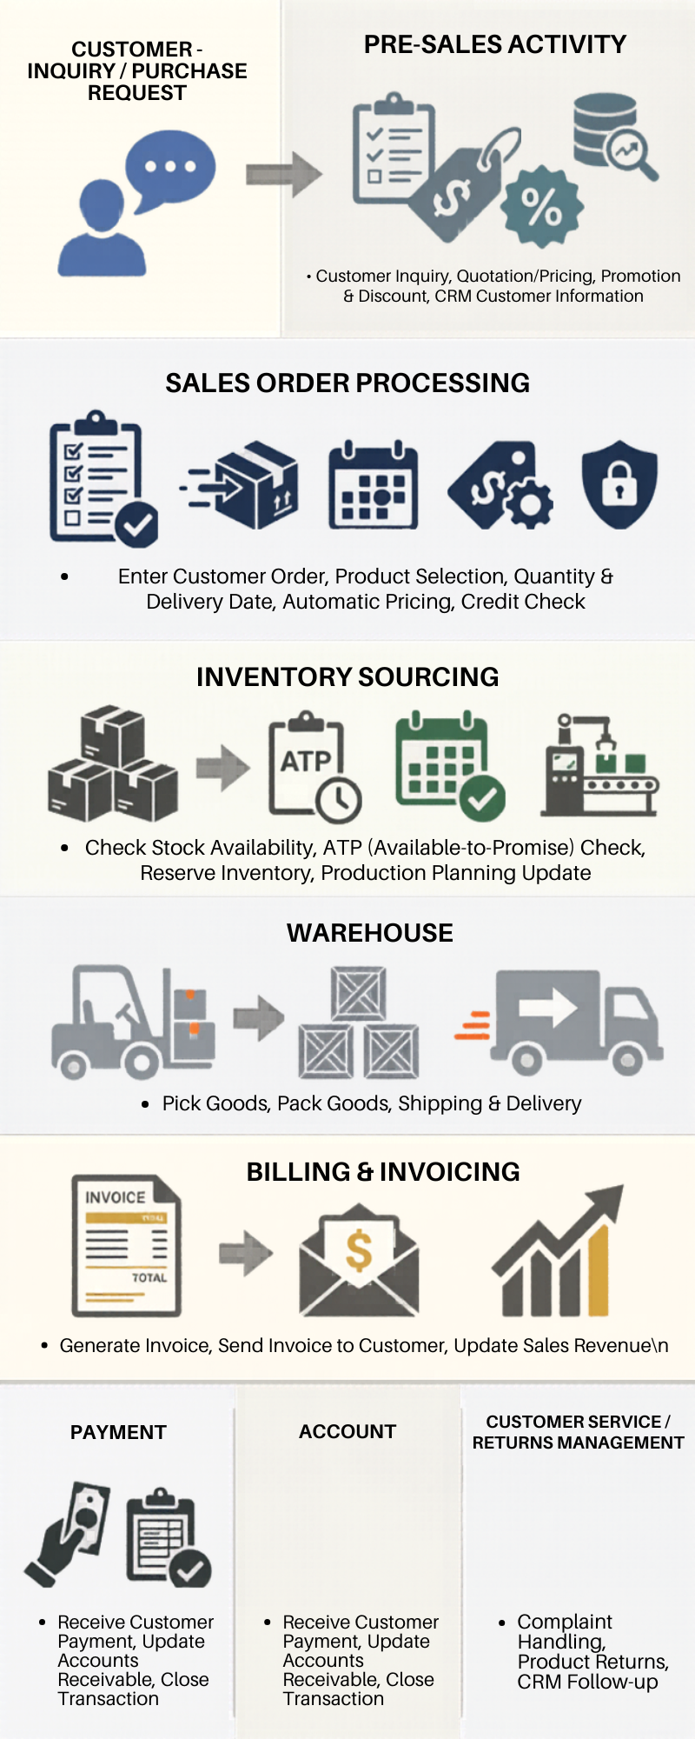

Overview
ERP integrates marketing, sales, inventory, warehouse, and accounting into one centralized system for faster and more accurate business operations.

Slide 4
Course Objective
Understand Fitter Snacker’s sales process problems
Explain issues caused by non-integrated systems
Learn sales & distribution in SAP ERP
Understand how SAP processes sales orders
Identify the benefits of CRM in ERP systems

Slide 5
Introduction
Marketing role: 1. Product Decide what to produce
2. Pricing decide price for products
3. Promotion adversiting and Marketing
4. Distribution customer delivery
Sales and Marketing Data Purposes: 1. Sales Records 2. Customer billing 3. Credit management
ERP Integration 1. Shared databases 2. Real-time information 3. Faster Communication 4.Better decision Making Take notes: wrong data in one module affects all departments

Slide 6
Automation ERP Tools
Marketing Tools
CRM System Customer data interaction
Social Media Marketing Campaigns
ERP Central System
SAP ERP
Output ERP
Inventory Stock Tracking
Accounting Billing and Finance
Email Marketing Promotions
Analytics Dashboard and Sales Reports
Oracle ERP
Microsoft Dynamics
Distribution Delivery Process
Customer Satisfaction

Slide 9

Course Synopsis
This course provides a comprehensive introduction to Enterprise Resource Planning (ERP) systems — integrated platforms used by organizations to manage business operations across departments in a unified manner.
Students will explore the core concepts, functionalities, and modules of ERP systems, and understand how ERP supports process integration, operational efficiency, and data-driven decision-making.

Slide 10
Course Learning Outcomes
CLO 1
CLO 2
Discuss current trends, issues, and challenges in enterprise resource planning.
CLO 3
Apply knowledge concepts into implementation.
Demonstrate understanding on the concepts of enterprise resources.

Slide 11
Course Topics

Slide 12
Business Functions and Business Process
The Development of ERP Systems
Marketing Information Systems and the Sales Order Process
Production and Supply Chain Management Information Systems
Customer Relationship Management
Process Improvement and ERP Implementation
Human Resource Processes with ERP
ERP Current Trends

Slide 13
Course Timetable & Planner

Slide 14
Lecture
Monday
Lab
Group 1 : Tuesday (8:00 AM – 10:00 AM)
2:00 PM – 4:00 PM
Lecture Theatre D1
01-02-09 (Learning Hub 6)
GA (G1 & G2)– Ms Anagha (anagha_21002260@utp.edu.my)
Lecturer – Nazleeni Samiha Haron (nazleeni@utp.edu.my)
Group 2 : Tuesday (10:00 AM – 12:00 PM)
Group 3 : Thursday (4:00 PM – 6:00 PM)
Group 4 : Wednesday (10:00 AM – 12:00 PM)
GA (G3 & G4) - Ms Fatima Alam (fatima_24003757@utp.edu.my)

Slide 15
Course Planner
Week 2
Quiz 1
Week 4
Quiz 2
Week 6
Test 1
Week 3
Assignment and Project Announced
Week 5
Quiz 3
Week 7
Quiz 4
Week 8
Assignment 1 Submission
Week 9
Quiz 5
Week 10
Project Submission
Week 11
Project Presentation
Week 12
Project Presentation

Slide 16
Coursework

Slide 17
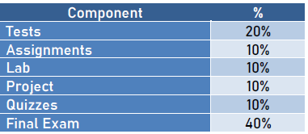
5%
5%
50%

Slide 18
Final Examination Eligibility
Eligibility to sit for the final examination are as follows.
Registered for the course
Fulfilled the minimum attendance requirement (90% attendance)

Slide 19
Condition for Passing a Course
Achieve a minimum of 40% marks for coursework (CW) component
For courses with Final Examination, achieve a minimum of 40% mark on Final Examination component.
Achieve a minimum of 40% marks for combined both components i.e. coursework and final examination components, for courses with final examination.

Slide 20

THANK YOU
© 2026 INSTITUTE OF TECHNOLOGY PETRONAS SDN BHD
All rights reserved. No part of this document may be reproduced, stored in a retrieval system or transmitted in any form or by any means (electronic, mechanical, photocopying, recording or otherwise) without the permission of the copyright owner.

